Slide 1
SELECTION SORT
31
18
42
7
25
13
select minimum
Concept • Structured algorithm • C realization • Mathematical analysis • Correctness
7
18
42
31
25
13
one final position per pass

Slide 2
Where Selection Sort belongs in the sorting chapter
CHAPTER MAP
Sorting is not one algorithm: it is a family of strategies with different cost trade-offs.
1
Selection methods
2
Insertion methods
3
Exchange methods
4
Divide / merge methods
Choose an extreme item, place it, shrink the unsorted set.
Grow a sorted region by inserting the next item.
Improve order through pairwise exchanges.
Exploit decomposition to reach O(n log n) behavior.
Selection Sort is the simplest “selection method”: repeatedly identify the smallest remaining key and put it into its final position.

Slide 3
Learning outcomes
OUTCOMES
Students should leave able to explain, derive, implement and defend the algorithm.
1
Explain
2
Trace
State the selection principle and the sorted/unsorted partition.
Perform a complete dry run with i, j and minIndex.
3
Implement
4
Derive
Write structured Selection Sort in C.
Obtain the exact comparison count n(n−1)/2.
5
Prove
6
Evaluate
Use a loop invariant to establish correctness.
Discuss stability, adaptiveness, space and write cost.

Slide 4
The sorting model: records, keys and order
FOUNDATIONS
A sorting algorithm usually rearranges records according to a chosen key.
R
Record
K
Key
<
Ordering relation
A complete data item: student, employee, transaction, node, etc.
The field used to establish order: roll number, salary, timestamp, weight, name, …
A rule such as ascending numeric order or lexicographic order.
Selection Sort only requires a consistent comparison operation on keys.

Slide 5
Core strategy: SELECT → PLACE → SHRINK
CORE IDEA
The algorithm is easiest to understand as a repeated commitment of one final position.
S
1. SELECT
P
2. PLACE
→
3. SHRINK
Find the smallest key in the current unsorted suffix.
Exchange it with the first position of that suffix.
Move the boundary one cell to the right.
current minimum
29
10
14
37
13
5
0
1
2
3
4
5
After placement, the chosen element will never move again.

Slide 6
Partition model: finalized prefix + unsorted suffix
INVARIANT
This boundary view is the central mental model for both tracing and proof.
boundary i = 3
finalized prefix
5
10
14
29
13
37
0
1
2
3
4
5
✓
Left of i
?
From i onward
Already in final ascending order. These positions will never be considered again.
Still unsorted. The next pass searches this suffix for its minimum.
The algorithm does not “sort the whole array at once”; it certifies one position per pass.

Slide 7
Structured algorithm specification
ALGORITHM
A textbook-style formulation separates control structure from implementation details.
SELECTION_SORT(A, n)
for i = 0 to n - 2
minIndex = i
for j = i + 1 to n - 1
if A[j] < A[minIndex]
minIndex = j
if minIndex != i
exchange A[i] and A[minIndex]
i
Outer loop
Chooses which array position is being finalized.
j
Inner loop
Performs a minimum search within the unsorted suffix.
↔
Exchange
Commits the selected minimum to its final position.

Slide 8
The three indices students must distinguish
TRACE
Most dry-run mistakes come from confusing the target, scanner and remembered minimum.
i = 1: target
minIndex = 4: best seen
finalized prefix
29
10
14
37
13
5
0
1
2
3
4
5
j = 5: current candidate
i
i
j
j
m
minIndex
First position in the unsorted suffix; the destination for the next minimum.
Moves through the suffix one item at a time.
Stores the index of the smallest key encountered so far.

Slide 9
Worked example: complete textbook-style dry run
EXAMPLE
Example created for this lecture: [29, 10, 14, 37, 13, 5]
29
10
14
37
13
5
0
1
2
3
4
5
Q
Question
M
Method
A
Answer
Which element belongs at index 0?
Scan all six values and remember the smallest.
5 is minimum, so 5 must be placed at index 0.

Slide 10
Pass 1: minimum search
EXAMPLE
At i = 0, the unsorted suffix is the entire array.
29
10
14
37
13
5
0
1
2
3
4
5
Comparisons made
10 < 29 → yes
14 < 10 → no
37 < 10 → no
13 < 10 → no
5 < 10 → yes
minIndex = 5 (value 5)
5 comparisons = n − 1

Slide 11
Pass 1: place the selected minimum
EXAMPLE
Exchange A[0] with A[5].
29
10
14
37
13
5
0
1
2
3
4
5
swap 29 ↔ 5
finalized prefix
5
10
14
37
13
29
Invariant established for one position: A[0] is now the smallest value of the full array.

Slide 12
Pass 2: repeat only on the suffix
EXAMPLE
At i = 1, search positions 1 … 5.
finalized prefix
5
10
14
37
13
29
0
1
2
3
4
5
The minimum of [10, 14, 37, 13, 29] is already 10 at index 1.
4
Comparisons
0
Swap
4 comparisons are still required; standard Selection Sort does not stop early.
No physical swap is needed if the implementation checks minIndex != i.

Slide 13
Pass 3: finalize index 2
EXAMPLE
At i = 2, search [14, 37, 13, 29].
finalized prefix
5
10
14
37
13
29
0
1
2
3
4
5
Minimum is 13 at index 4 → exchange A[2] and A[4].
finalized prefix
5
10
13
37
14
29
3 comparisons in this pass.

Slide 14
Remaining passes and final array
EXAMPLE
Every pass reduces the unsorted suffix by exactly one position.
After pass 3
5
10
13
37
14
29
3 comps
After pass 4
5
10
13
14
37
29
2 comps
After pass 5
5
10
13
14
29
37
1 comp
Sorted result: [5, 10, 13, 14, 29, 37]

Slide 15
Complete trace table
TRACE TABLE
A compact representation of the entire algorithm execution.
Pass | i | Suffix searched | Selected minimum | Action | Array after pass
1 | 0 | 0…5 | 5 @ index 5 | swap 0↔5 | 5 10 14 37 13 29
2 | 1 | 1…5 | 10 @ index 1 | no swap | 5 10 14 37 13 29
3 | 2 | 2…5 | 13 @ index 4 | swap 2↔4 | 5 10 13 37 14 29
4 | 3 | 3…5 | 14 @ index 4 | swap 3↔4 | 5 10 13 14 37 29
5 | 4 | 4…5 | 29 @ index 5 | swap 4↔5 | 5 10 13 14 29 37
Pass
i
Suffix searched
Selected minimum
Action
Array after pass
Observation: comparison count decreases 5, 4, 3, 2, 1 — a triangular pattern.

Slide 16
C implementation: clean structured version
C LANGUAGE
The code mirrors the algorithm specification almost line for line.
void selectionSort(int a[], int n)
{
for (int i = 0; i < n - 1; ++i) {
int minIndex = i;
for (int j = i + 1; j < n; ++j) {
if (a[j] < a[minIndex])
minIndex = j;
}
if (minIndex != i) {
int temp = a[i];
a[i] = a[minIndex];
a[minIndex] = temp;
}
}
}
1
Structured loops
Outer loop controls placement; inner loop performs selection.
2
Index, not copy
minIndex stores location so the final exchange is O(1).
3
Avoid self-swap
The conditional exchange reduces unnecessary writes.

Slide 17
Function contract and assumptions
C LANGUAGE
A senior-level implementation should state what the function expects and guarantees.
PRE
Preconditions
POST
Postcondition
MEM
Side effects
• a points to storage for at least n integers
• n ≥ 0
• integer comparisons have a total order
The same elements remain, but arranged so that a[0] ≤ a[1] ≤ … ≤ a[n−1].
The array is modified in-place; no auxiliary array is allocated.
Permutation property + ordering property = a complete functional specification of sorting.

Slide 18
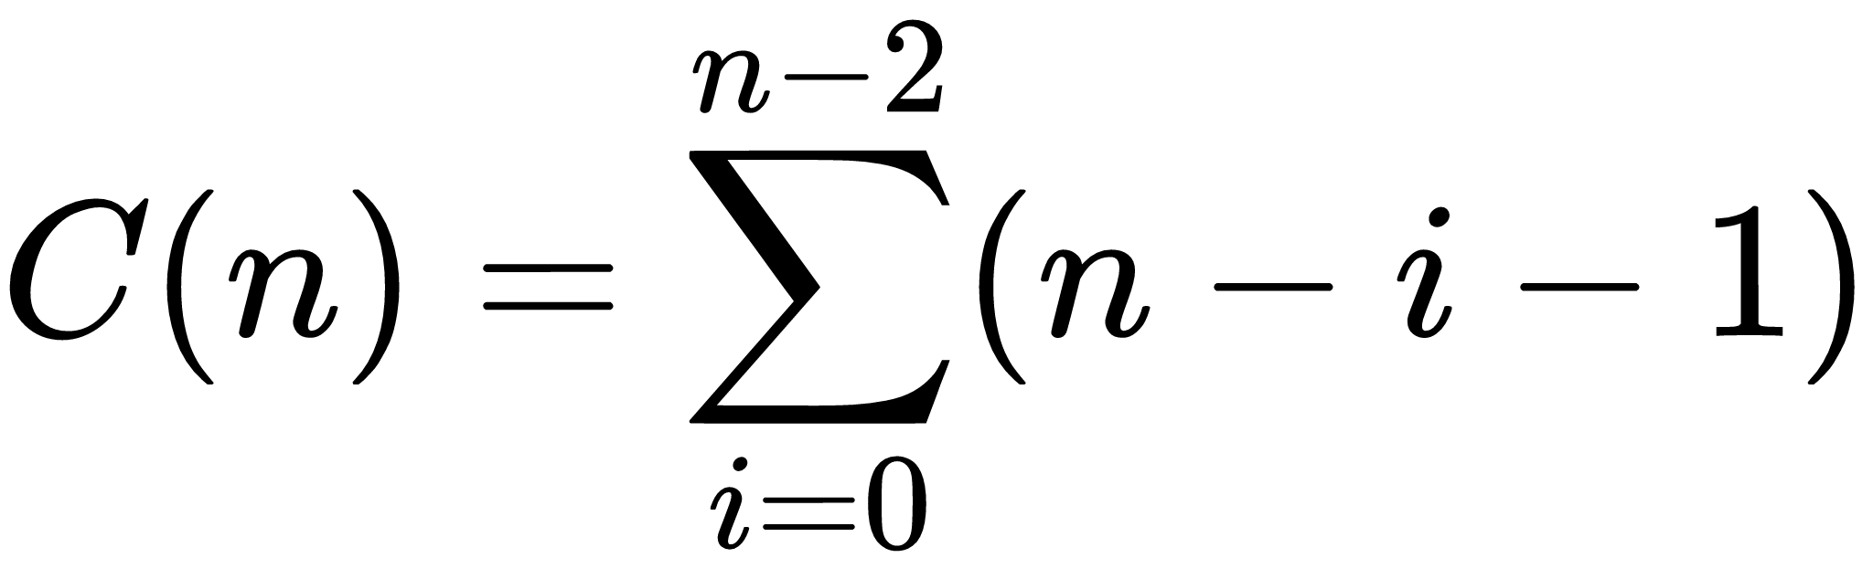
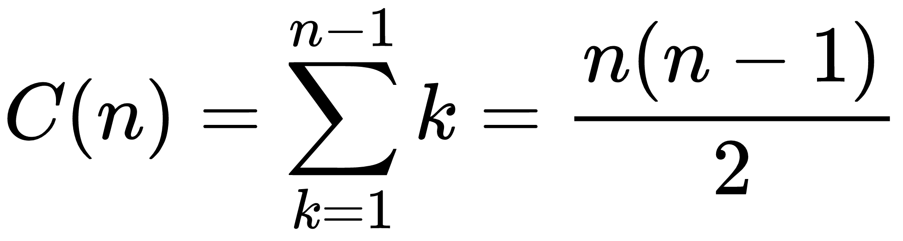
Exact number of comparisons
MATHEMATICS
Unlike many algorithms, standard Selection Sort performs a fixed number of key comparisons.
Pass-by-pass count
n−1
n−2
n−3
…
2
1
For n = 6: 5 + 4 + 3 + 2 + 1 = 15 comparisons

Slide 19
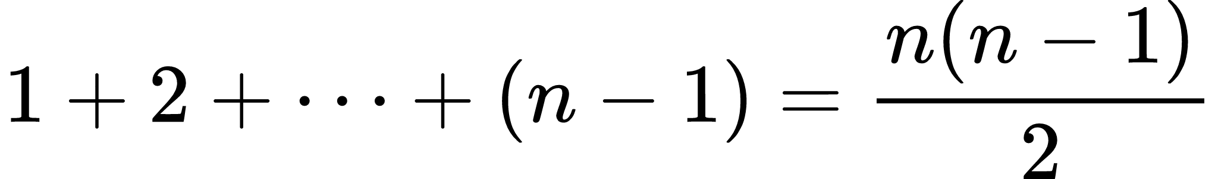
Why the comparison sum is triangular
MATHEMATICS
Each pass contributes one shorter row of comparisons.
pass 1
pass 2
pass 3
△
Geometric interpretation
pass 4
The inner-loop work fills half of an n × n comparison grid, up to lower-order terms.
pass 5
5 + 4 + 3 + 2 + 1 = 15 cells

Slide 20
Best, average and worst case are all quadratic
COMPLEXITY
Input order changes swap behavior, but not the number of comparisons.
Case | Input pattern | Comparisons | Asymptotic time
Best | already sorted | n(n−1)/2 | Θ(n²)
Average | random order | n(n−1)/2 | Θ(n²)
Worst | any difficult order | n(n−1)/2 | Θ(n²)
Case
Input pattern
Comparisons
Asymptotic time
Key reason: the inner loop never uses “already sorted” as an early-stop condition.

Slide 21
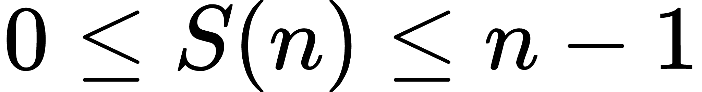
Swap analysis: Selection Sort moves data sparingly
COST MODEL
This is the algorithm’s most distinctive practical advantage.
0
Best swap count
n−1
Maximum swaps
W
Why it matters
0 swaps if the array is already sorted and self-swaps are skipped.
At most one exchange per outer pass → n − 1 exchanges.
If writing a record is expensive, minimizing data movement can outweigh extra comparisons.
For large records, implementations often sort references/pointers rather than copying whole records.

Slide 22
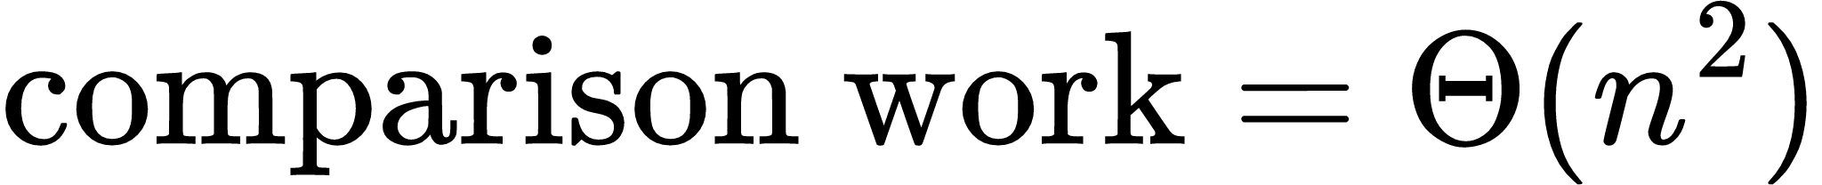
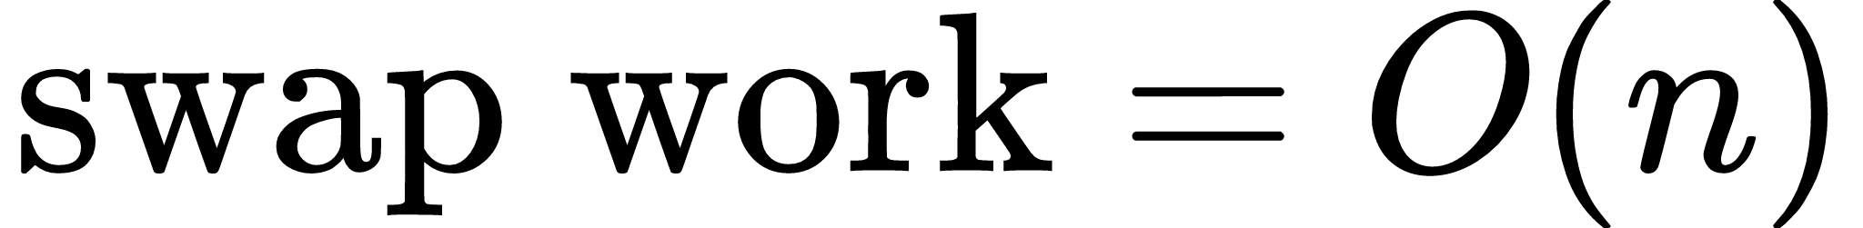
A finer cost model: comparisons vs data writes
COST MODEL
Big-O alone hides the fact that different primitive operations may have very different costs.
C
Comparisons
W
Writes / assignments
Exactly n(n−1)/2 key comparisons. This dominates CPU work for large n.
A conventional three-assignment swap costs roughly 3 writes, and there are at most n−1 swaps.
This asymmetry explains why Selection Sort is sometimes discussed when write cost is constrained.

Slide 23
Space complexity and in-place behavior
MEMORY
The algorithm rearranges elements inside the original array.
4
Stored state
0
No second array
O(1)
Meaning
i, j, minIndex and one temporary variable.
The input array itself is the workspace.
Memory use does not grow with n.

Slide 24
Correctness proof: loop invariant
PROOF
A formal proof explains why every completed pass is safe and permanent.
Invariant before pass i: A[0 … i−1] contains the i smallest elements of the original array, in sorted order.
1
Initialization
2
Maintenance
3
Termination
Before i = 0, the prefix is empty. The claim is trivially true.
The inner loop finds the minimum of A[i … n−1]. Placing it at A[i] extends the correct prefix by one.
When i reaches n−1, the first n−1 elements are the n−1 smallest in order; the last element must also be correct.

Slide 25
Invariant visualized: why the next placement is final
PROOF
At the moment of exchange, the chosen minimum cannot belong anywhere to the right of i.
finalized prefix
5
10
13
37
14
29
0
1
2
3
4
5
Prefix contains the 3 smallest values
Suffix minimum = 14
Since every suffix element is ≥ 14, moving 14 to the first suffix position preserves sorted order and fixes index 3 permanently.

Slide 26
Stability: standard Selection Sort is not stable
PROPERTY
Equal keys can reverse their original relative order during a long-distance swap.
Suppose records carry equal key 4 but different identities A and B.
4A
4B
2
✗
Relative-order change
Originally 4A appeared before 4B. After the swap, 4B appears before 4A. Therefore the method is unstable.
swap minimum 2 with first position
2
4B
4A

Slide 27
How to make a stable selection variant
EXTENSION
Replace the long-distance swap with remove-and-shift insertion.
4A
4B
2
↔
Trade-off
Stability is restored, but data movement can become Θ(n²) because each pass may shift many elements.
Instead of swapping 2 with 4A:
1) save 2 2) shift 4A and 4B right 3) insert 2 at front
2
4A
4B

Slide 28
Algorithmic properties: in-place, adaptive, online
PROPERTIES
These labels describe behavior beyond asymptotic running time.
In-place
YES
Uses O(1) extra storage.
Stable
NO
Equal records may reverse relative order.
Adaptive
NO
Sorted input still causes all comparisons.
Online
NO
Requires access to the remaining suffix before fixing the next position.

Slide 29
Selection vs Insertion vs Bubble Sort
COMPARISON
All are simple quadratic sorts, but they pay for work in different ways.
Property | Selection | Insertion | Bubble
Best time | Θ(n²) | Θ(n) | Θ(n) with early stop
Worst time | Θ(n²) | Θ(n²) | Θ(n²)
Max data movement | O(n) swaps | O(n²) shifts | O(n²) swaps
Stable? | No | Yes | Yes
Adaptive? | No | Yes | Yes with flag
Key strength | few swaps | excellent near-sorted | simple exchange intuition
Property
Selection
Insertion
Bubble
Selection Sort is not “better” overall; it is different because it deliberately minimizes exchanges.

Slide 30
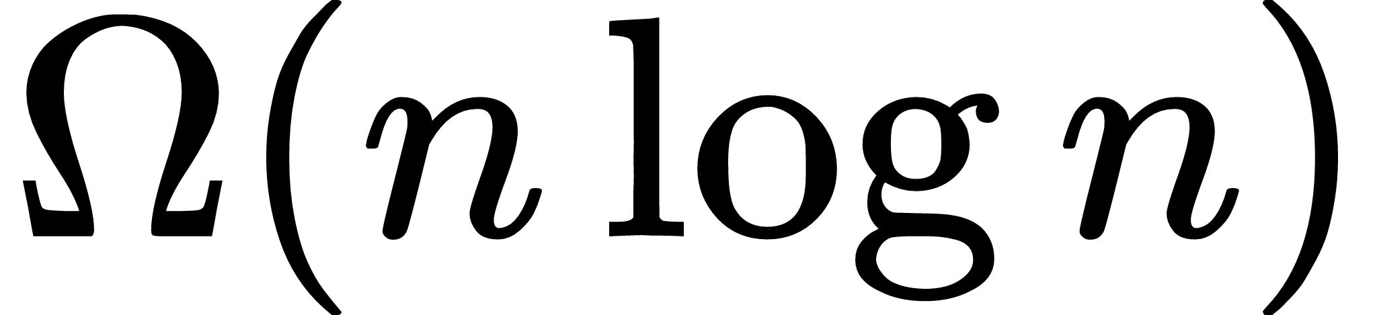
Why Θ(n²) is not optimal for general comparison sorting
THEORY
Selection Sort is conceptually important, but faster comparison sorts exist.
LB
Comparison lower bound
n²
Selection Sort
!
Lesson
Any general deterministic comparison sort requires on the order of n log n comparisons in the worst case.
Uses approximately n²/2 comparisons — asymptotically larger.
Choose it for simplicity or low swap count, not for large-scale speed.

Slide 31
Descending-order Selection Sort
VARIANT
The structure is unchanged; only the selection criterion changes.
for (int i = 0; i < n - 1; ++i) {
int maxIndex = i;
for (int j = i + 1; j < n; ++j)
if (a[j] > a[maxIndex])
maxIndex = j;
if (maxIndex != i)
swap(a[i], a[maxIndex]);
}
min
Ascending
Select the minimum remaining key.
max
Descending
Select the maximum remaining key.
Everything else — bounds, comparison count, Θ(n²) time and O(1) space — remains the same.

Slide 32
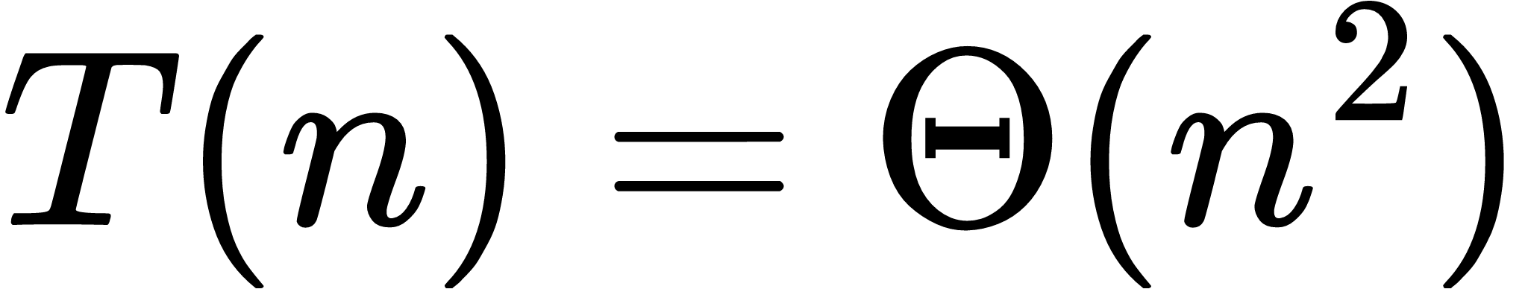
Recursive formulation
VARIANT
Selection Sort can also be expressed as “select one minimum, then sort the remainder.”
selectionSortRec(a, start, n)
if start >= n - 1
return
minIndex = index of minimum in a[start ... n-1]
exchange a[start] and a[minIndex]
selectionSortRec(a, start + 1, n)
R
Teaching value
The recursive form reveals the same mathematical structure as the triangular comparison sum.

Slide 33
Instrument the C program: make the cost visible
LAB
Counting operations turns complexity analysis into an experimentally testable claim.
long long cmp = 0, swp = 0;
for (int i = 0; i < n - 1; ++i) {
int minIndex = i;
for (int j = i + 1; j < n; ++j) {
++cmp;
if (a[j] < a[minIndex]) minIndex = j;
}
if (minIndex != i) {
int t = a[i]; a[i] = a[minIndex]; a[minIndex] = t;
++swp;
}
}
15
Prediction for n = 6
cmp must always equal 15.
4
Swap count
Depends on the input; for our example it is 4.
LAB
Experiment
Try 100 random arrays with fixed n and verify cmp never changes.

Slide 34
Common mistakes in exams and programs
PITFALLS
These errors change the algorithm or lead to incorrect complexity claims.
×
Swap inside the inner loop
×
Set minIndex only once
Wrong: repeated exchanges. Correct: remember minIndex, then swap once.
Wrong: it must reset to i at the start of every pass.
×
Scan from j = 0
×
Use i < n
Wasteful and conceptually wrong; the prefix is already finalized.
The last position needs no pass; use i < n−1.
×
Claim best case O(n)
×
Call it stable
Incorrect for standard Selection Sort; all key comparisons still occur.
Standard long-distance swapping can reverse equal records.

Slide 35
University exam / viva questions
ASSESSMENT
Questions that test conceptual, mathematical and implementation mastery.
1.
Define Selection Sort using the selection principle.
2.
Trace the array after each pass for a given input.
3.
Derive the exact comparison count.
4.
Why are best and worst times both Θ(n²)?
5.
Prove correctness using a loop invariant.
6.
Is it stable? Demonstrate with tagged duplicates.
7.
What is the maximum number of swaps?
8.
Why is it called an in-place algorithm?
9.
Compare Selection and Insertion Sort.
10.
Modify it for descending order or stable behavior.

Slide 36
Selection Sort — 60-second revision sheet
SUMMARY
The minimum set of facts every student should be able to reproduce.
1
Principle
2
Comparisons
Repeatedly select the minimum of the unsorted suffix and place it at the boundary.
n(n−1)/2 exactly.
3
Time
4
Swaps
Best = Average = Worst = Θ(n²).
At most n−1; often fewer if self-swaps are skipped.
5
Space
6
Properties
O(1) auxiliary storage → in-place.
Unstable, non-adaptive, offline.
7
Proof
8
Signature
Finalized prefix contains the smallest elements in sorted order.
Few data exchanges, many comparisons.

